Slide 1
Mottled Stars - Methodology
How Does Starspot Coverage Affect Stellar Brightness Variability?
Miles L. Johnson

Slide 2
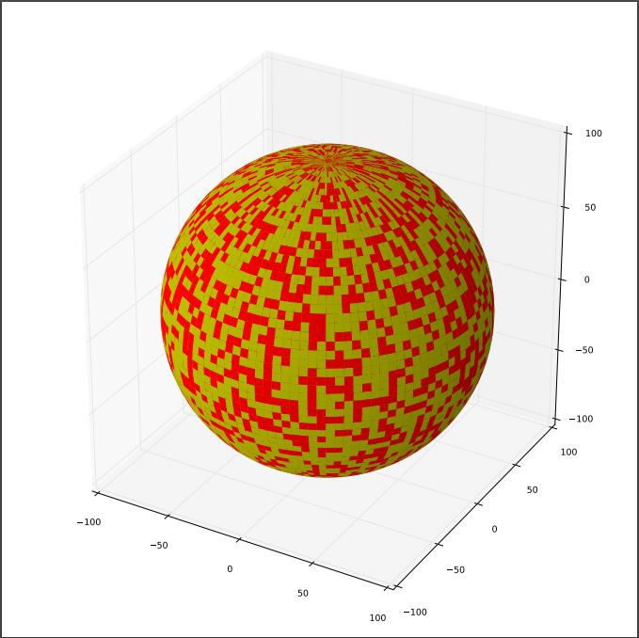
Building 3D Stellar Models

Slide 3
Three-dimensional Model to two-dimensional projection

Slide 4
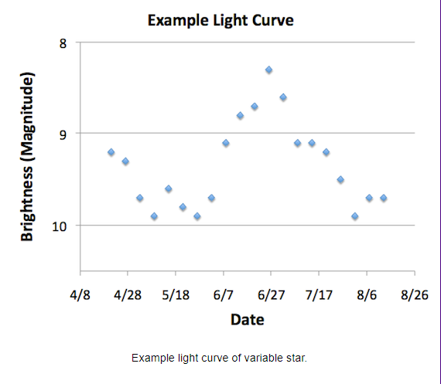
Brightness Integration
Image Credit: NASA Goddard Space Flight Center

